Slide 1
Prototyping, Objects & Classes in JavaScript
How JS really creates objects
Understanding this, new, and __proto__
From Functions → Prototypes → Classes

Slide 2
What is an Object?
JavaScript is object-based language
Everything revolves around objects
Object = collection of key-value pairs

Slide 3
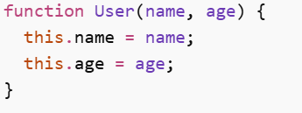
Constructor Function
Used to create multiple objects
What new does internally:
Creates empty object {}
Links it to prototype
Sets this → new object
Returns object
👉 This is the backbone of JS object creation

Slide 4
Understanding this
this depends on how function is called
function User(name) { this.name = name; }
With new → this = new object
Without new → this = global / undefined (strict mode)
⚠️ Important interview point

Slide 5
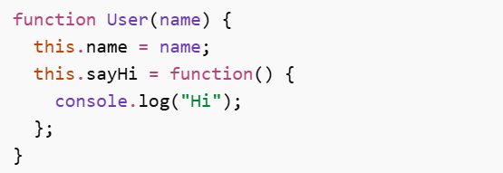
Problem Without Prototype
❌ Every object gets its own copy → memory waste

Slide 6
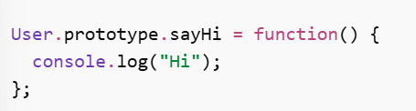
Enter Prototype
JS solves this using prototype Shared across all objects

Slide 7

What is __proto__?
Every object has hidden property → __proto__ It connects object to its prototype This is called Prototype Chain
JS searches properties upward

Slide 8
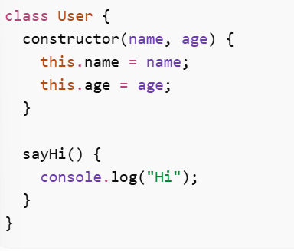
Classes (Modern JS)
Cleaner syntax over prototypes

Slide 9
Behind the Scenes
Classes are syntactic sugar
User.prototype.sayHi
✔ Still uses prototype internally

Slide 10
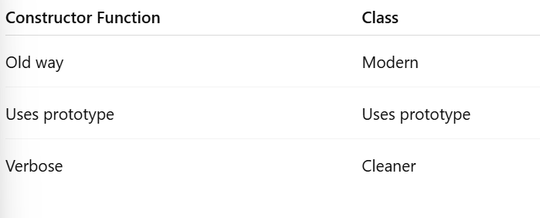
Key Differences

